Slide 1
Online E-Commerce System
for Sales and Order Management
Avishek Bista
TU Roll No: 14892/22
Supervisor: Pravin Ratna Shakya
Designation: Lecturer, SXC
Date 20/02/2026

Slide 2

Introduction
Web-based e-commerce system for managing product sales and customer orders.
Automates product browsing, cart, order, and transaction recording.
Designed mainly for small & medium businesses needing digital sales management.

Slide 3
Problem Statement
Limited market reach due to lack of online presence
No customer engagement or digital marketing tools
Competition from bigger brands
No feedback or review system
Need for an e-commerce platform to boost visibility and sales

Slide 4
Objective
Develop a web-based e-commerce platform for online selling
Implement cart, order processing, and transaction recording
Provide admin dashboard for product & order management

Slide 5
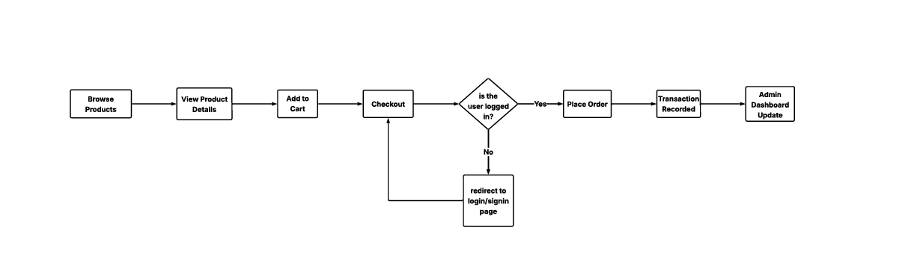
Design
System Design Flow

Slide 6




Tools Used
Tools & Technologies Used
Python (Backend)
Django Framework
HTML
CSS
JavaScript
SQLite

Slide 7

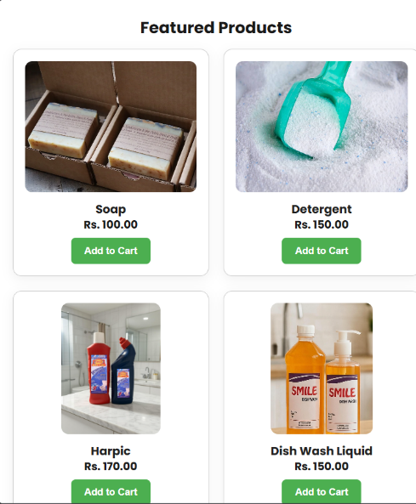
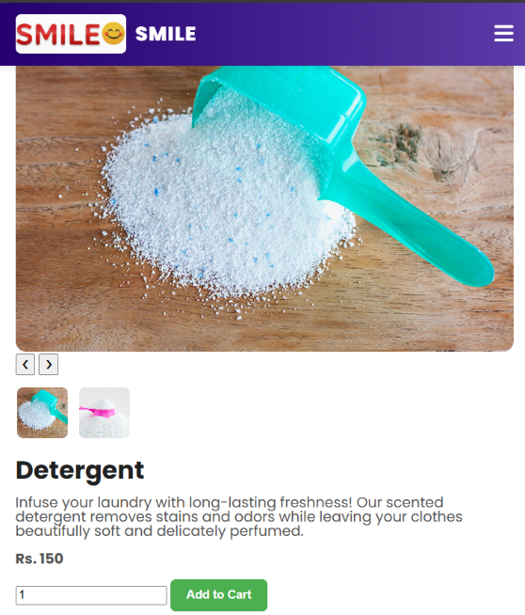
Deliverables
User Side Screens
Home Page
Product Listing
Product Detail Page

Slide 8
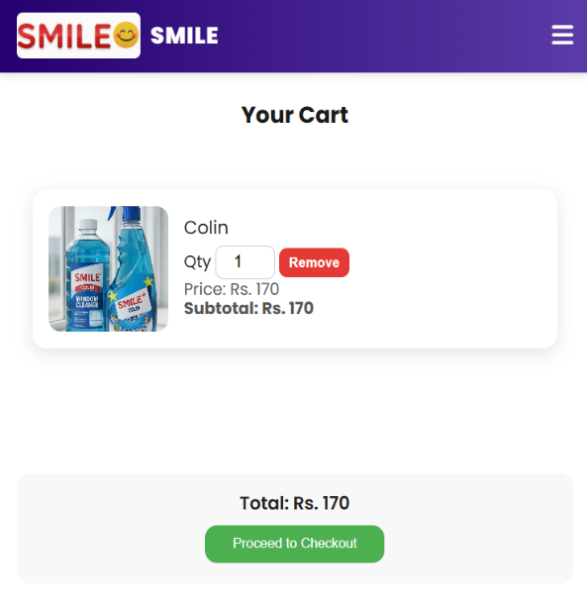
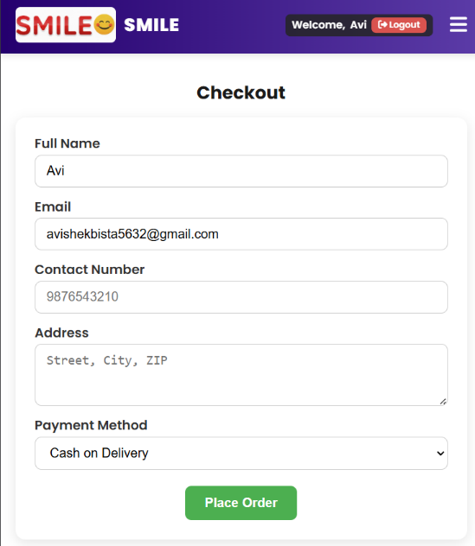
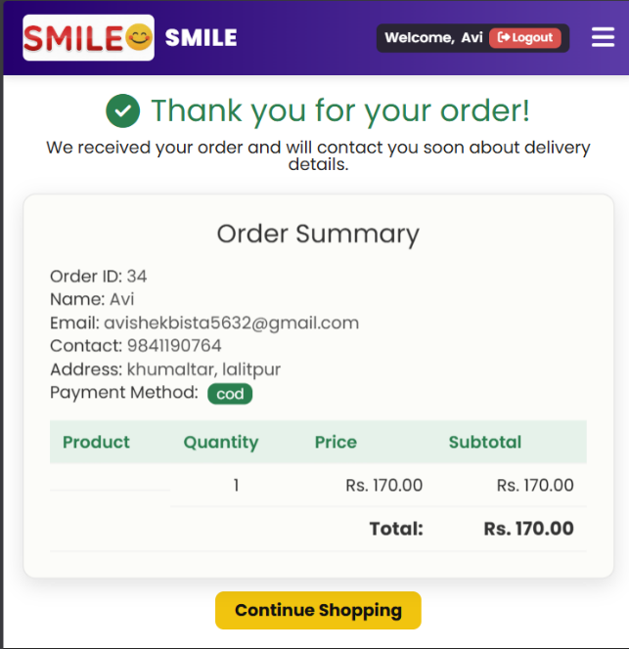
Deliverables
Order Process Screens
Cart Page
Checkout Page
Order Confirmation

Slide 9
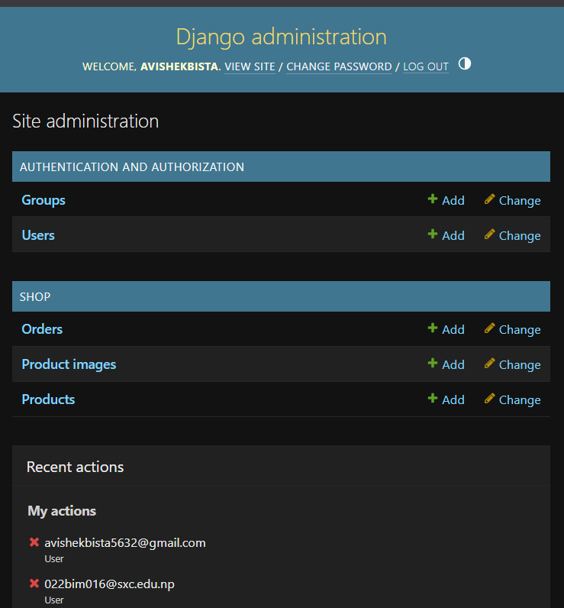
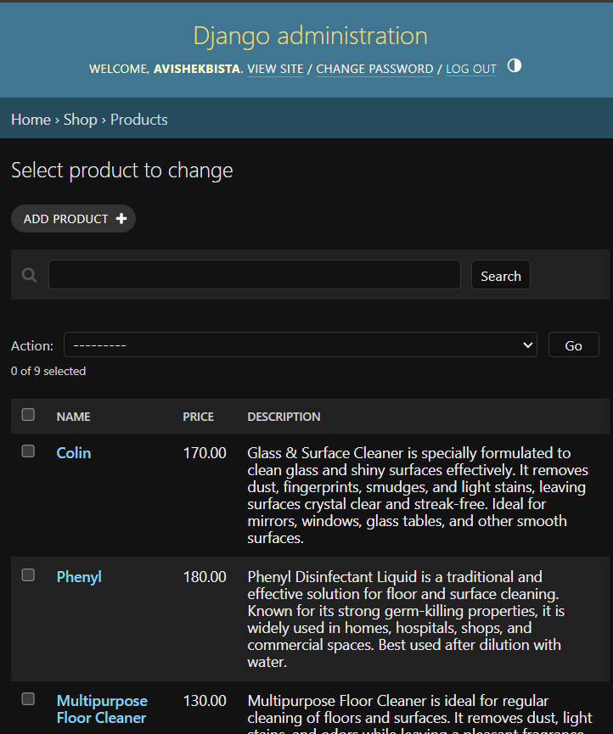
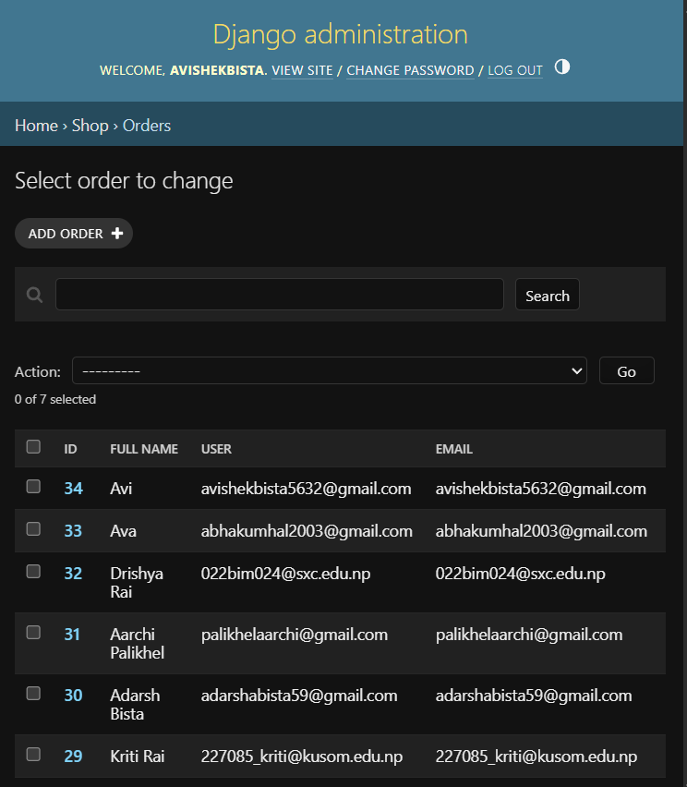
Deliverables
Admin Side
Admin Dashboard
Product Management
Order View Panel

Slide 10
Critical Analysis
Strengths
Automated transaction recording
Improved data accuracy
Reduced manual errors
Scalable modular design
Limitations
No integrated payment gateway
Limited analytics
Basic inventory features

Slide 11
Conclusion
Successfully developed a functional e-commerce TPS system
Automates sales and order management
Improves efficiency and data reliability
Provides base for future MIS & analytics features

Slide 12
Project Demo
Admin panel - https://avishekbista.pythonanywhere.com/admin/login/?next=/admin/shop/order/
User panel – https://avishekbista.pythonanywhere.com/

Slide 13
Thank You

